Slide 1



To BIT or not to BID? (Theoretical and practical analysis of virtual currencies in case of Bitcoin)
Faculty of Law, University of Rijeka
Department of Economics
Ivan Rubinić, mag. oec.
Long Beach, 2014.

Slide 2

What is Bitcoin? (Introduction)
Bitcoin is software-based online payment system described by Satoshi Nakamoto in 2008. and introduced as open-source software in 2009.
Payments are recorded in a public ledger using its own unit of account (Bitcoin).
It is a form of digital currency (physical form is absent), created and held electronically. It can be used to buy things electronically and in that sense it is no different than conventional dollars.
Bitcoin is commonly referred to as cryptocurrency and it can be divided into smaller unit called Satoshi (one hundred milionth of a BTC).

Slide 3
What is it based on? (coindesk.com)
System is runned by The Bitcoin protocol
It is based on mathematics unlike conventional currencies that had been based on fixed quantity of metal (gold, silver…) or fiat currencies.
Bitcoin has several features that set it apart from fiat currencies:
It is decentralized
It is easy to set up and it is fast
It is anonymous
It is completely transparent
Transaction fees are miniscule
Transactions are irreversible

Slide 4
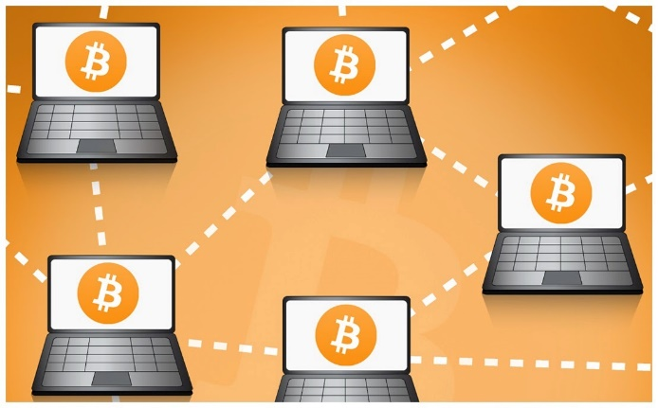
It’s decentralized
Base for the Bitcoin protocol is a peer-to-peer system which means that there is no need for a third party.
Therefore, in theory, bitcoin network is not controled by central authority (fully decentralized monetary system).
Bitcoins are being created by a community of people that anyone can join.
In theory, there is no authority (financial institution) which can tinker with monetary policy and in that sense devalue or revalue Bitcoin currency.

Slide 5
It’s anonymus and transparent
Bitcoins are stored in wallet with digital credentials for your bitcoin holdings and allows you to access them.
Wallet uses public-key cryptography, in which two keys, one public and one private are generated. Public key can be thought of as an account number or name and the private key, ownership credentials.
Bitcoin is transferred to the next owner when the next owner gives a public key and previous owner uses his private key to publish a record into system announcing that the ownership has changed to the new public key.
Bitcoin protocol stores details of every single transaction that occurred in the network in huge version of general ledger (Block chain).

Slide 6
Negligible fees and irreversible process
Bitcoin doesn’t charge fees for either national or international transfers.
Bitcoin is not the first private money, not the first digital currency, and not first currency based on cryptography, but it has been the first to rely on peer to peer network decentralization to avoid double spending.
Bitcoin protects against double spending by verifying each transaction added to the block chain to ensure that the inputs for the transaction had not previously already been spent.

Slide 7

How are Bitcoins created - Mining process
Miners use special software to solve math problems (Bitcoin algorithm), and upon completing the task they receive certain amount of coins.
They are created each time a user discovers new block (finds hash value).
Software is creating new units until it reaches amount of 21 million unites (currency with Finite Supply).
The rate of block creation is approximately consistant over time (6 per hour) with 50 % reduction every four years.
Halving (in theory) continues until 2110-2140 when 21 million BTC have been issued.

Slide 8
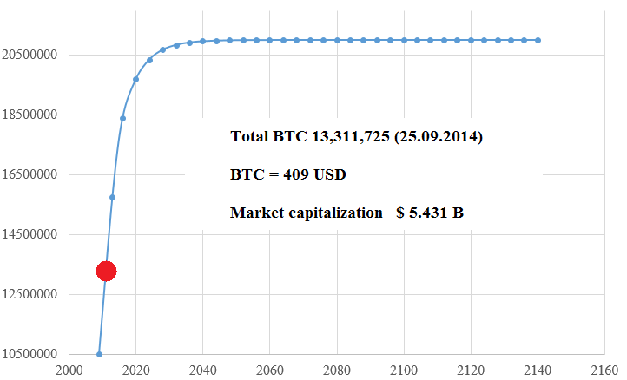
Total bitcoin unit supply over time (Projection)
Number of units in circulation
Period
data source: bitcoin.it

Slide 9
How can one obtain Bitcoins?
Earn Bitcoins from mining
Earn Bitcoins by accepting them as a means of payment
(Time magazine: „All transactions using digital or alternative currencies had been illegal in
California until 30.06.2014” http://time.com/2942212/california-bitcoin-legalize/)
Earn Bitcoins trough trading
Earn Bitcoins as a regular income
Earn Bitcoin from interest payments
Various ways (donations, gambling, getting tipped, completing tasks on websites...)

Slide 10
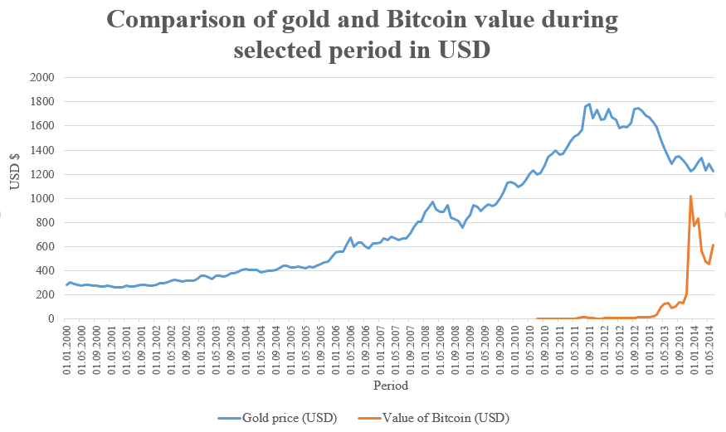
Why price of bitcoins soared and why it became the world pionner in virtual currency field?
data source: quandl.com and bundesbank.de, own calculations

Slide 11
Why price of bitcoins soared and why it
became the world pionner in virtual currency field?
Financial crisis that caused meltdown of the economy started 2008-2009.
It caused a transfer of assets form real-estate and financial sphere to investment into commodities that are traditionally considered as a stable store of values.
Historically, Gold is best known commodity of that type because quantity of this metal is limited and, therefore, it is great way how to hedge your portfolio in times when usage of expansive monetary policy is highly likely.
In this sense, bitcoin is similar to gold (except there is no intrinsic value) and when the value of gold started to decrease due to the price roof that it had reached and partial recovery of financial market, value of bitcoin soared because it was cleverly designed financial product with finite quantity.

Slide 12
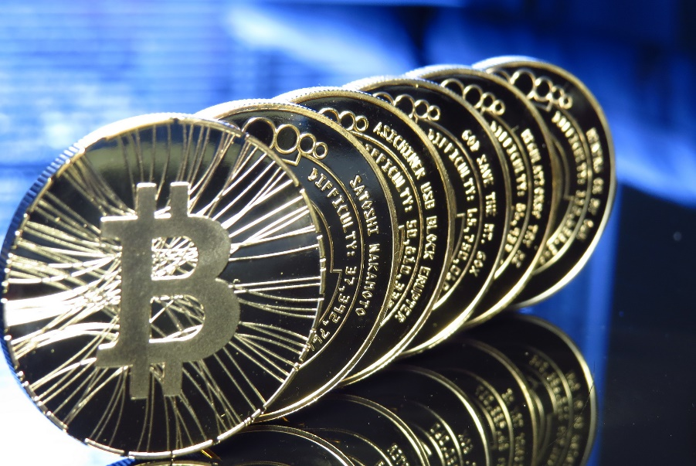
Theoretical and tehnical problems which goes against favour of bitcoin usage:
Illegal activities, speculations and nature of this currency,
Theoretical base for digital currency usage,
Regulation and taxation issue,
Disputable status of independent and decentralized currency,
Mining problems,
Skepticism towards implementation of new, unregulated, theologies in finance sphere.

Slide 13

Illegal activities, speculations and nature of bitcoin currency
Can currency be anonymous and transparent at the same time? (Slide 5)
Why would somebody give you approximately 27,000 $ for solving impractical mathematical equations?
According to Forbes (2014.), currently, more than 90 percent of bitcoin accounts are in a buy-and-hold mode!
„At some point in the growth of a boom all aspects of property ownership become irrelevant except the prospect for an early rise in price. Income from the property, or enjoyment of its use, or even its long-run worth is now academic.”
J. K. Galbraith (The Great Crash 1929.)

Slide 14
Brief history of bitcoin commodity Source: selected data available at historyofbitcoin.org
Date | Event
2007 | Satoshi began working on the Bitcoin concept
18.8.2008 | Bitcoin is registered
3.1.2009 | The Genesis Block is mined
12.1.2009 | First Bitcoin transaction
5.10.2009 | An exchange rate is established
6.2.2010 | A currency exchange is born
17.7.2010 | MtGox is established
15.8.2010 | A vulnerability in the system is discovered and exploited, resulting in the generation of 184 billion Bitcoins
18.9.2010 | First collective mining starts
29.9.2010 | Another exploit discovered
28.10.2010 | First ever short sale
9.12.2010 | First call option contract sold
2011 | Silk Road opens for business
28.1.2011 | 25% of total Bitcoins generated
9.2.2011 | Bitcoin reaches parity with USD (1:1)
12.4.2011 | First put option sold

Slide 15
Brief history of bitcoin commodity Source: selected data available at historyofbitcoin.org
Date | Event
12.6.2011 | The Great Bubble of 2011
13.7.2011 | 25,000 BTC theft reported
19.7.2011 | Major breach at MtGox
26.7.2011 | Bitomat (Poland) loses 17,000 Bitcoins
5.8.2011 | MyBitcoin loses 150,000 Bitcoins
6.9.2011 | Creation of physical Bitcoins
13.2.2012 | Second largest Bitcoin exchange shuts down
1.3.2012 | Linode hacked 46,000 BTC stolen
9.5.2012 | FBI report on Bitcoin leaked
11.5.2012 | Bitcoinica hacked (18,000 BTC)
3.9.2012 | Bitfloor hacked (24,000 BTC)
24.9.2012 | Bitcoin Savings and Trust investigated for running Ponzi scheme
8.3.2013 | BitInstant hacked (12,000 $)
11.3.2013 | Glitch causes halt in transactions
28.3.2013 | Market cap reaches $ 1 billion
1.4.2013 | Bitcoin surpasses $100
20.4.2013 | Bitcoin Central is hacked
1.5.2013 | Gaming company caught secretly mining Bitcoins from customer computers

Slide 16
Brief history of bitcoin commodity Source: selected data available at historyofbitcoin.org
Date | Event
2.5.2013 | First Bitcoin ATM (San Diego)
14.5.2013 | MtGox funds seized by Homeland
18.5.2013 | Online casino that accepts Bitcoin is founded
23.5.2013 | Bitcoin central gets hacked
1.6.2013 | Winklevoss Bitcoin Trust filed
6.8.2013 | Bitcoin ruled currency by Texas judge
12.8.2013 | 22 Bitcoin companies subpoenaed
20.8.2013 | Bitcoin ruled private money in Germany
2.10.2013 | FBI shuts down Silk Road (3.6 milllion USD seized)
2.10.2013 | BitcoinTalk.org hacked
31.10.2013 | BitMarket.eu closes the doors
13.11.2013 | Senate hearing of potential Bitcoin risks and threats
19.11.2013 | Bitcoin goes above $ 1000
2.12.2013 | 96,000 Bitcoins are stolen from Sheep Marketplace
5.12.2013 | China bans Bitcoin transactions
26.1.2014 | BitInstant CEO charged with money laundering
12.09.2014 | First bitcoin swap approved

Slide 17
Conventional money theory (simplified)
Money is commodity that has a status of universal equivalent in trade.
Money functions:
Schlichter, D. (2011): „All additional functions that can be assigned to money are the result of money being the accepted medium of exchange.”
 | 1. Medium of Exchange | 2. Store of Value | 3. Unit of Account
Gold | *** | **** | ***
Fiat currencies | ***** | *** | ***
Cryptocurrencies | **** | ??? | ???

Slide 18
Money circulation
M – total amount of money in circulation
V – velocity of money
P – price level
Q – indeks of real value of final expenditures
M x V = P x Q
Bitcoin as currency increases amount of money and hence leads to increasing price levels (V and Q constant).
Since bitcoin is inherently deflationary it will benefit in a way that its usage will cause value decline of other currencies while bitcoin will experience rise.

Slide 19
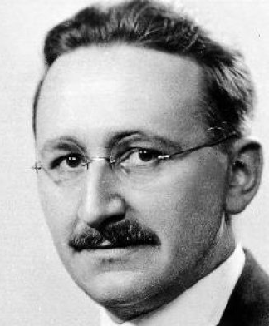
Theoretical background?
Theoretical background for bitcoin currency can be found within Hayek’s work „Denationalization of money, free banking and inflation targeting” 1977. (Claim of bitcoin advocates).
Hayek claims that the government should be depived of its monopol to issue of money.
Central argument is that a price level stability can be achieved only by removing national governments of their monopoly to create money.

Slide 20
Hayek suggests that allowing private enterprise to supply public with other media of exchange is a solution to monopoly problem, and that we need a free market with concurrent currencies.
In his model, creation of money would be under control of private banks and they would supply the market with various types of currencies, therefore, creating competitiveness.
In order to acchieve price stability every bank should tie its liabilities to certain basket of commodities for keeping its rate of change in-line with its promises.
This theory faces strong objections which can be the subject of another lecture, but for now the important fact is that Hayek’s theory is not appropriate in case of bitcoin.
BASED ON FOLLOWING ARGUMENTS, WE WILL CONCLUDE THAT THERE IS NO ECONOMIC THEORY THAT WOULD APPROVE AND EXPLAIN USAGE OF BITCOIN CURRENCY

Slide 21

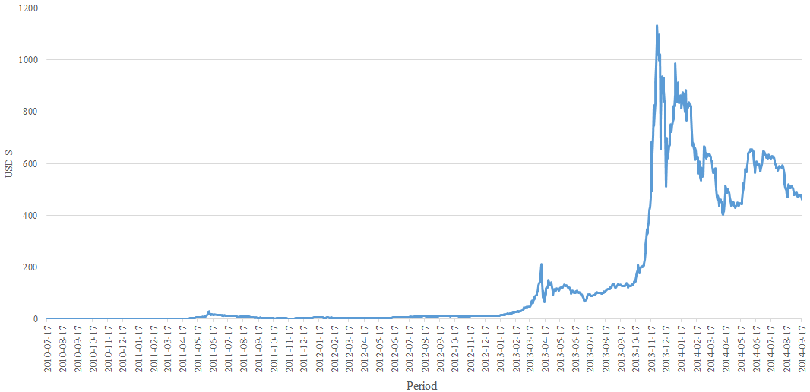
USD/Bitcoin Weighted Price (Volatility analysis)
China restricted Bitcoin exchange for local RMB
Russia defined Bitcoin as dubios activity
MtGox filed for bankrupcy (theft of 477 million USD in BTC)
Soaring caused by wide acceptance of Bitcoin
Source: quandl.com

Slide 22
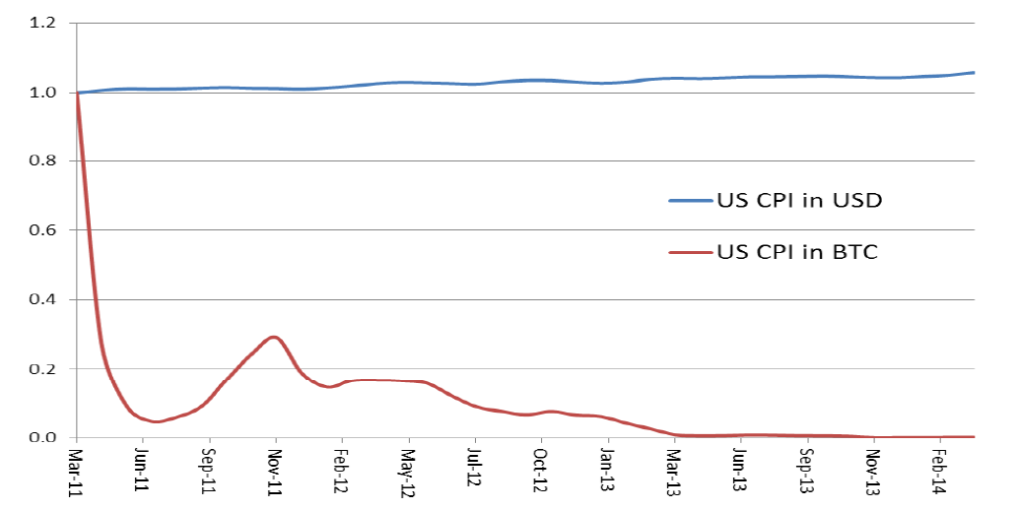
Volatility dilemma
How to achieve price stability with inelastic fixed supply of bitcoins?
Source: Ametrano, F. M. 2014. „Hayek Money” p. 19

Slide 23
Volatility dilemma solution
If obtaining price stability is main target supply of bitcoin should be adjusted (fixed) to the price of goods.
The monetary base increment should be distributed pro-quota to every digital wallet, without unfair wealth distribution.
It is farly easy to achieve ballance if we consider only one good in a model, however, if monetary policy targets commodity price stability as basket of goods, implementation is becoming complicated!
What if a price of good decreases and amount of coins in wallet is not big enough to adjust falling price?
It also implies that final quantity of bitcoins is changing which is contradictory to the main concept.

Slide 24


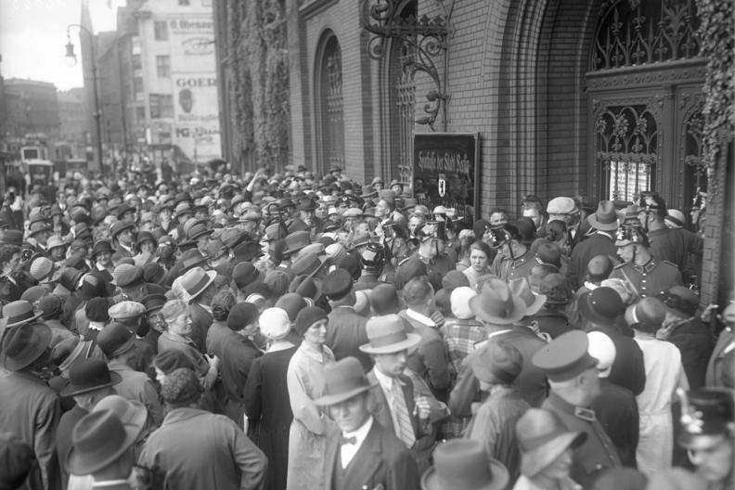
Other dilemmas
Unknown issuer
Currency (Bank) Runs and absence of deposit insurance
Bitcoin nature as a global phenomenon
Physical currency as a necessity
Deflationary spiral problem

Slide 25

Regulation and taxation issue Commodity? Currency? Private money? Property? Security?
Federal regulators in the United States have generally not issued specific guidance on Bitcoin’s status.
„Bitcoin is a currency or form of money”
United States District Court, Texas, 2013.
„IRS Boosts Bitcoin’s Status As Speculative Investment”
Money Management, 2014.
„IRS: Bitcoin is property not currency”
Bloomberg, 2014.

Slide 26


Which institution can regulate virtual currencies?
FED?
SEC?
"I think it's important to understand that this is a payment innovation that's taking place entirely outside the banking industry, The Federal Reserve simply does not have the authority to supervise or regulate Bitcoin in any way.„
Federal Reserve Chair Janet Yellen
Question: is bitcoin a security?
The strongest regulatory hook for deeming Bitcoin to be a security may be categorizing it a an "investment contract”.

Slide 27


Which institution can regulate virtual currencies?
US TREASURY?
CFTC?
„If Bitcoin Remains Impractical,
Treasury Will Let it Be” BloombergBusinessWeek, 2014.
Investing in Bitcoins could come under CFTC jurisdiction as being a commodity for future delivery
CFTC would have a colorable claim to regulate derivative products of Bitcoins (i.e., Bitcoin futures, swaps, rolling spot Bitcoin transactions, etc.).
However, market for those products remains small and outside of the United States.

Slide 28
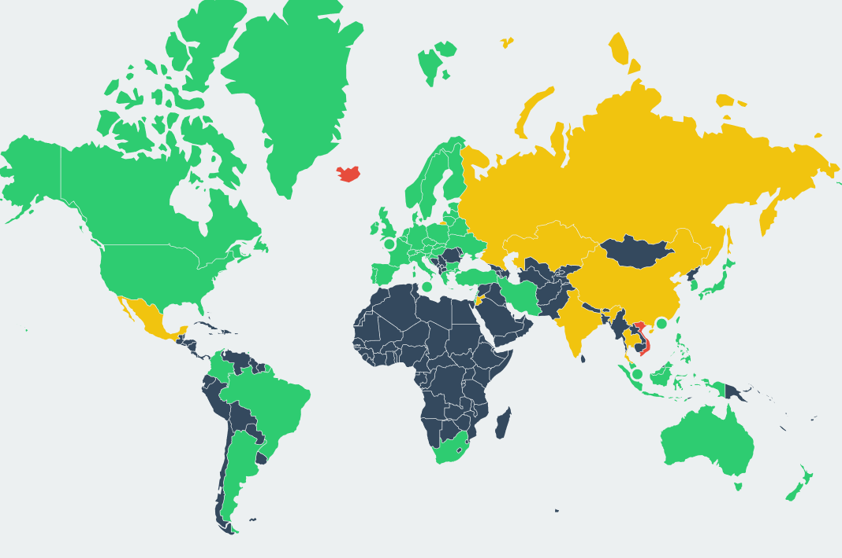
Legality of Bitcoin by country
PERMISSIVE
CONTENTIOUS
HOSTILE
UNKNOWN
Source: bitlegal.io

Slide 29
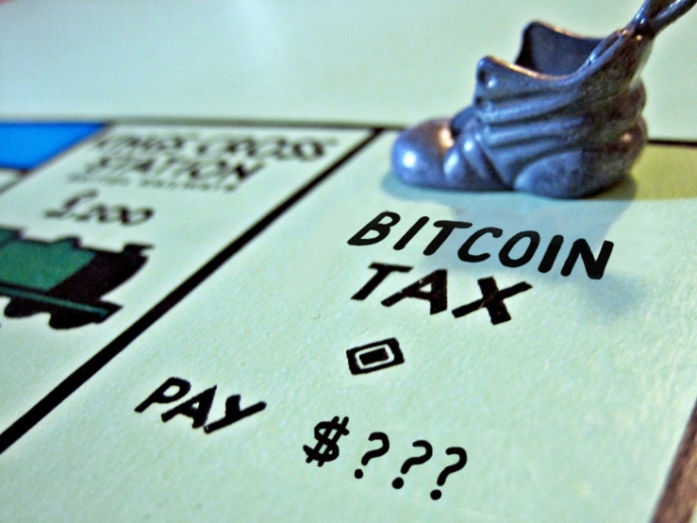
There are three ways how bitcoin generate income:
Since value of a bitcoin fluctuates, one can generate net income selling them at the higher price than the original purrchase price (capital gains taxation).
If they are received by merchants sa payment for goods and services.
Bitcoins obtained through mining activities are a subject of standard income taxation.
Can a country have an adequate taxation program if regulatory framework is not defined and if status of „currency or commodity” is unknown?
If take the anonymity of bitcoin into account then one can simply deduct that tax evasion is not only feasible but inevitable.

Slide 30

Does statement that bitcoin is independent and decentralized currency holds water?
Independence is defined as freedom from the control, influence…
As long as bitcoin is a part of the society, it cannot be independent because a simple ban from one relevant country can cause collapse of the currency.
What will happen when a bitcoin will eventually confront the full weight of the regulatory state?

Slide 31

Mining problems
Using computing power of third parties to achieve faster mining performance (without knowledge and consent of the third party)
Distributed Denial of Service Attacks (DDoS)
The 51% cartel attack
A Goldfinger attack

Slide 32
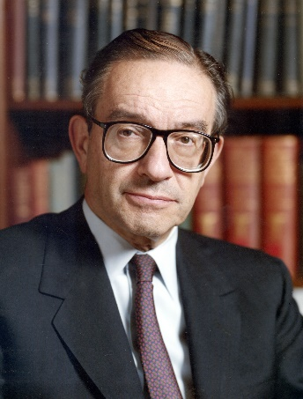
Skepticism towards implementation of new theologies in finance sphere
“Not only have individual financial institutions become less vulnerable to shocks
from underlying risk factors, but also the financial system as a whole has
become more resilient.”
(2004.)
„I really didn't get it until very late in 2005 and 2006.“
(2007.)

Slide 33
Conclusion
ADVANTAGES
DISADVANTAGES
It is easy to set up and it is fast
Low and irreversible transaction fees
Without central authority???
(possible disadvantage)
New and uninvestigated financial product
History is full of illegal and questionable activity
Absence of relevant theoretical background
Highly volatile value and an unknown issuer
Undefined legal status
Unregulated commodity and absence of consumer protection
Anonymity and blurry taxation status
Illegal or undefined in most countries of the world

Slide 34
Thank you for your attention! Questions, comments or remarks?
For any further questions author is at your disposal via email: irubinic1@pravri.hr

